Slide 1

Superior Grasping Performance
Superior
Notes:
When objects are rotated, as you can see, EquiGraspFlow outperforms existing ones in grasp success rate.

Slide 2
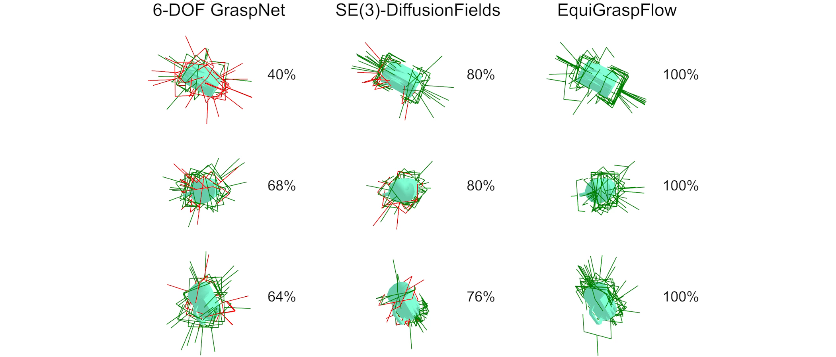
Consistent Grasping Performance w.r.t Rotation
Inconsistent
Consistent
Notes:
Our model also consistently performs well regardless of object orientation.

